Slide 1
Synchronous Sequential Circuits Design
W
Combinational
Combinational
Flip-flops
circuit
Z
circuit
Q
Clock
Moore Type Sequential Circuits: Output depends only on the present state.
Mealy Type: Output depends on both state and primary input
Figure 8.1. The general form of a sequential circuit.

Slide 2
Example 1: A simple input pattern detection circuit
We wish to design a circuit that meets the following specification
The circuit has one input W, and one output z.
All changes in the circuit occur on the positive edge of a clock signal.
The output z is equal to 1 if during two immediately preceding clock cycle the input w was equal to 1. Otherwise the value of z is equal to 0.
Clockcycle:
t
0
t
1
t
2
t
3
t
4
t
5
t
6
t
7
t
8
t
9
t
10
w
:
0
1
0
1
1
0
1
1
1
0
1
z
:
0
0
0
0
0
1
0
0
1
1
0
Figure 8.2. Sequences of input and output signals.

Slide 3
State Diagram
Reset
w
=
1
w
=
0
A
⁄
z
=
0
B
⁄
z
=
0
w
=
0
w
=
0
w
=
1
C
⁄
z
=
1
w
=
1
Figure 8.3. State diagram of a simple sequential circuit.

Slide 4
State Table
Present
Next state
Output
state
w
=
0
w
=
1
z
A
A
B
0
B
A
C
0
C
A
C
1
Figure 8.4. State table for the sequential circuit in Figure 8.3.

Slide 5
Next state
Present
w
=
0
w
=
1
Output
state
z
y
2
y
1
Y
2
Y
1
Y
2
Y
1
A
00
00
01
0
B
01
00
10
0
C
10
00
10
1
11
dd
dd
d
Figure 8.6. State-assigned table for the sequential circuit in Figure 8.4.

Slide 6
Y
1
y
1
w
Combinational
Combinational
z
circuit
circuit
Y
2
y
2
Clock
Figure 8.5. A general sequential circuit with input w, output z, and two state flip-flops.

Slide 7
y
2
y
1
00
01
11
10
Ignoring don't cares
Using don't cares
w
0
0
0
d
0
Y
1
=
wy
1
y
2
Y
1
=
wy
1
y
2
1
1
0
d
0
y
2
y
1
w
00
01
11
10
0
0
0
d
0
Y
2
=
wy
1
y
2
+
wy
1
y
2
Y
2
=
wy
1
+
wy
2
1
0
1
d
1
=
w
(
y
1
+
y
2
)
y
1
y
2
0
1
0
0
0
z
=
y
1
y
2
z
=
y
2
1
1
d
Figure 8.7. Derivation of logic expressions for the sequential circuit in Figure 8.6.

Slide 8
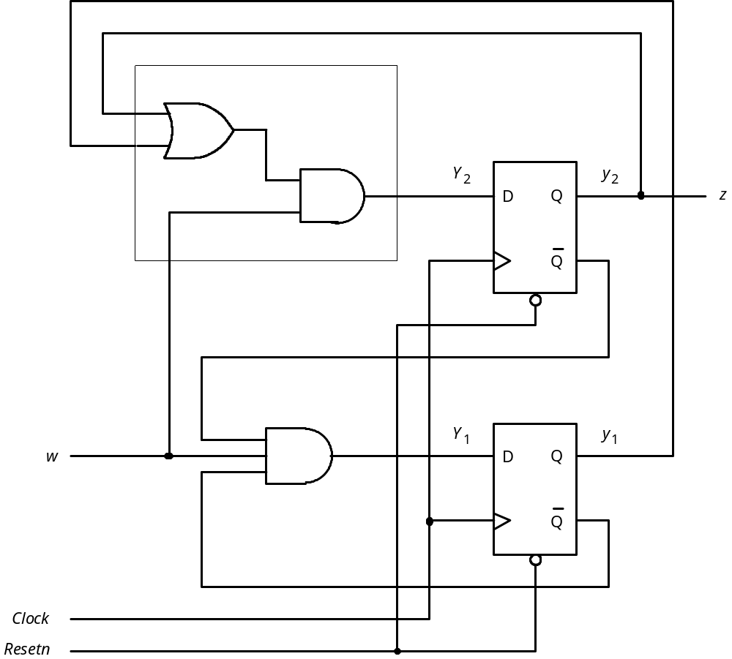
Figure 8.8. Final implementation of the sequential circuit derived
in Figure 8.7.

Slide 9
t
t
t
t
t
t
t
t
t
t
t
0
1
2
3
4
5
6
7
8
9
10
1
Clock
0
1
w
0
1
y
1
0
1
y
2
0
1
z
0
Figure 8.9. Timing diagram for the circuit in Figure 8.8.

Slide 10
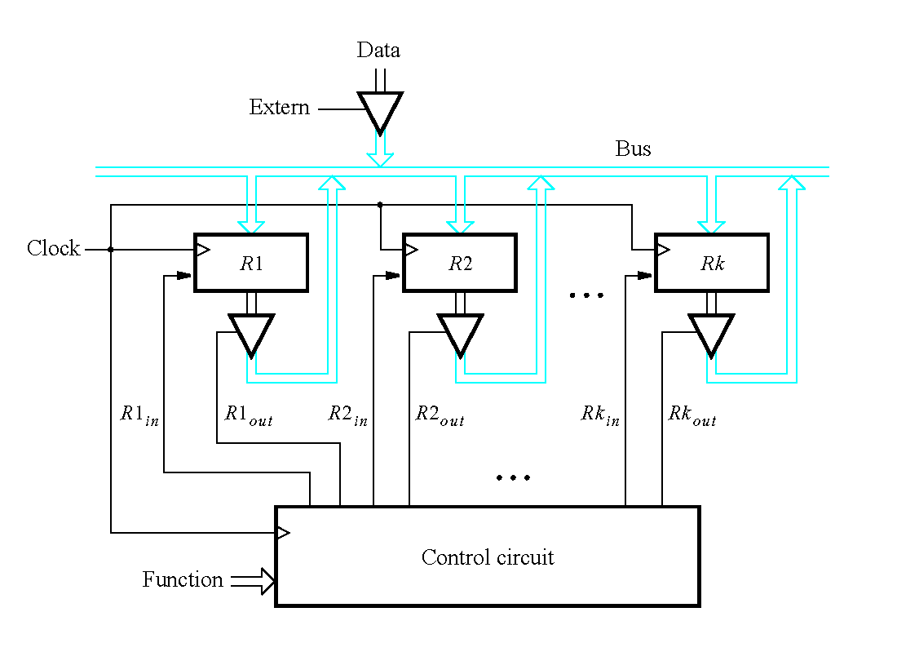
Example-2 K registers connected with n-bit bus.
Figure 7.55. A digital system with k registers.

Slide 11
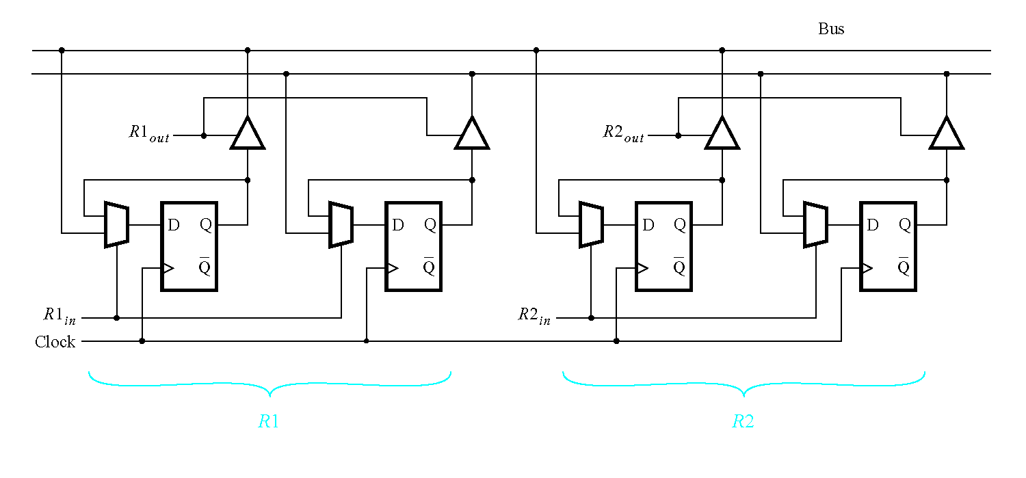
Figure 7.56. Details for connecting registers to a bus.

Slide 12
R
1
out
R
1
in
w
R
2
out
Control
circuit
R
2
in
R
3
out
Clock
R
3
in
Done
Figure 8.10. Signals needed in Example 8.1.

Slide 13
w
=
0
A
⁄
No
transfer
Reset
w
=
1
B
⁄
R
2
=
,
out
1
R
3
in
=
1
w
=
0
w
=
1
w
=
0
w
=
1
C
⁄
R
1
=
,
out
1
R
2
in
=
1
w
=
0
w
=
1
D
⁄
R
3
=
,
,
out
1
R
1
in
=
1
Done
=
1
Figure 8.11. State diagram for Example 8.1.

Slide 14


Present
Next state
Outputs
state
w = 0
w = 1
A
A
B
0
0
0
0
0
0
0
B
C
C
0
0
1
0
0
1
0
C
D
D
1
0
0
1
0
0
0
D
A
A
0
1
0
0
1
0
1
Figure 8.12. State table for Example 8.1.

Slide 15

Present
Next state
state
Outputs
A
00
00
0
1
0
0
0
0
0
0
0
B
01
10
1
0
0
0
1
0
0
1
0
C
10
11
1
1
1
0
0
1
0
0
0
D
11
00
0
0
0
1
0
0
1
0
1
Figure 8.13. State-assigned table for the sequential circuit in Figure 8.12.

Slide 16
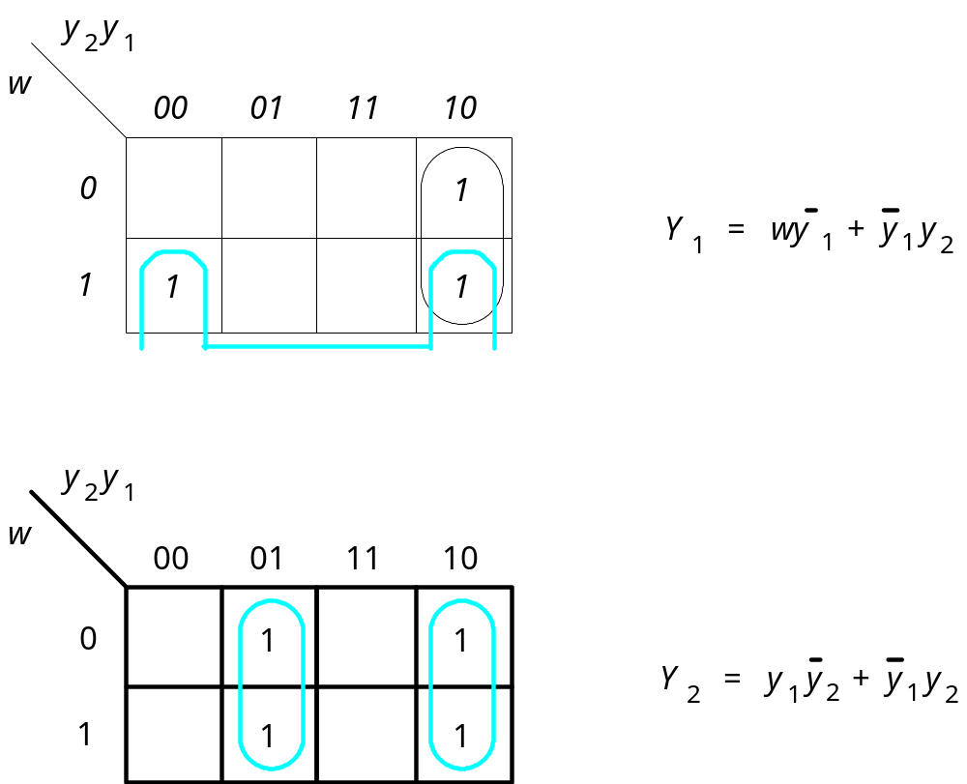
Figure 8.14. Derivation of next-state expressions for the
sequential circuit in Figure 8.13.

Slide 17
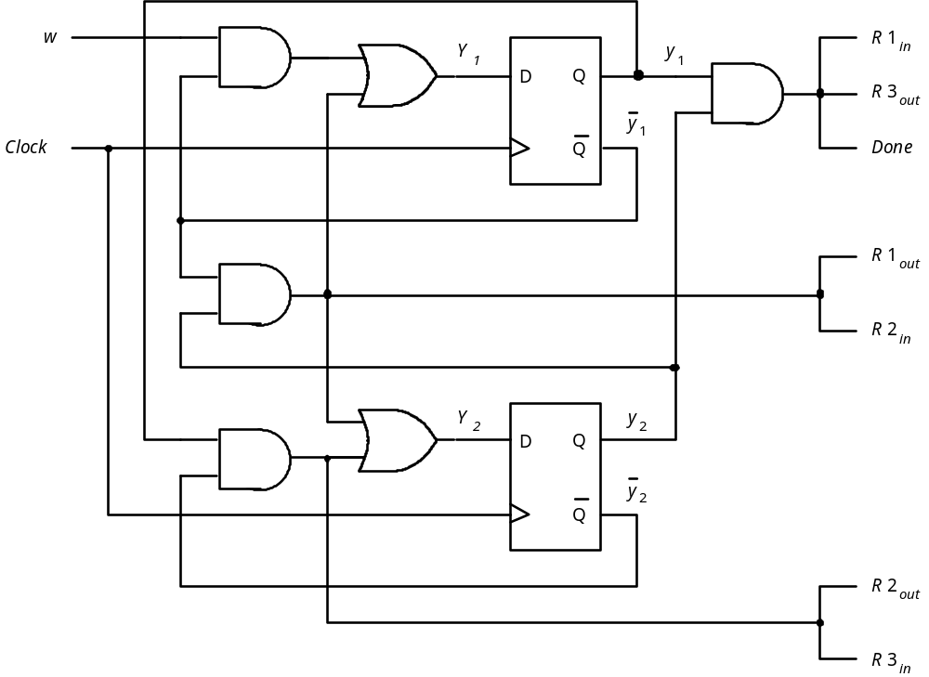
Figure 8.15. Final implementation of sequential circuit in Figure 8.13.

Slide 18
State Assignment Problem : Case Study Example 1
Clockcycle:
t
0
t
1
t
2
t
3
t
4
t
5
t
6
t
7
t
8
t
9
t
10
w
:
0
1
0
1
1
0
1
1
1
0
z
:
0
0
0
0
0
1
0
0
1
1
0
Next state
Next state
Present
Present
w
=
0
w
=
1
Output
Output
state
state
w
=
0
w
=
1
z
z
y
y
Y
Y
Y
Y
y
2
y
1
Y
2
Y
1
Y
2
Y
1
2
1
2
1
2
1
A
00
00
01
0
A
00
00
01
0
B
01
00
11
0
B
01
00
10
0
C
11
00
11
1
C
10
00
10
1
10
dd
dd
d
11
dd
dd
d
Y₁=wy₁y₂; Y₂=w(y₁+y₂); z=y₂
Y₁=w; Y₂=wy₁; z=y₂
Figure 8.16. Improved state assignment for the sequential circuit in Figure 8.4. Example 1

Slide 19
Y
y
2
2
z
D
Q
Q
Y
y
w
1
1
D
Q
Clock
Q
Resetn
Y₁=wy₁y₂; Y₂=w(y₁+y₂); z=y₂
Y₁=w; Y₂=wy₁; z=y₂
Figure 8.17. Final circuit for the improved state assignment
in Figure 8.16.

Slide 20
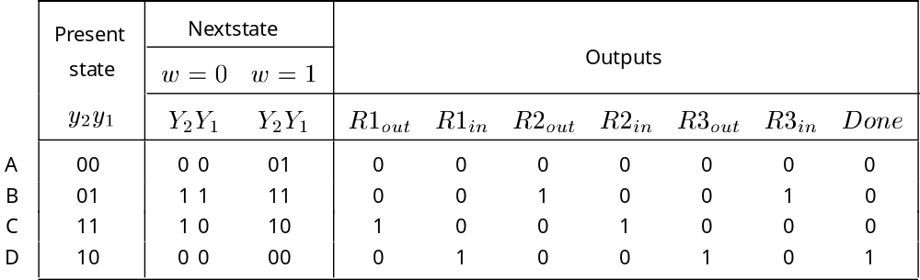
Improved State Assignment : Case Study 2 Example 2
Figure 8.18. Improved state assignment for the sequential circuit in Figure 8.12.

Slide 21
y
2
y
1
w
00
01
11
10
0
1
Y
1
=
wy
2
+
y
1
y
2
1
1
1
y
2
y
1
w
00
01
11
10
0
1
1
Y
2
=
y
1
1
1
1
Figure 8.19. Derivation of next-state expressions for the sequential
circuit in Figure 8.18.

Slide 22
ONE-HOT Encoding : Case Study Example 1
Clockcycle:
t
0
t
1
t
2
t
3
t
4
t
5
t
6
t
7
t
8
t
9
t
10
w
:
0
1
0
1
1
0
1
1
1
0
z
:
0
0
0
0
0
1
0
0
1
1
0
Present
Next state
Output
state
w
=
0
w
=
1
z
A
A
B
0
B
A
C
0
C
A
C
1
Figure 8.4. State table for the sequential circuit in Figure 8.3.
Present
Nextstate
state
w
=
0
w
=
1
Output
y
y
y
z
3
2
1
Y
3
Y
2
Y
1
Y
3
Y
2
Y
1
A
001
001
010
0
B
010
001
100
0
C
100
001
100
1
Figure 8.20. One-hot state assignment for the sequential circuit in Figure 8.4.

Slide 23
Using the remaining states as don’t care the resulting
Expression are
Y₁=w
Y₂=wy₁
Y₃=wy₁
z=y₃
These expressions are not simpler than those obtained using the state assignment in previous case. Though in this case state assignment is not advantageous, there are many cases where this approach is attractive.

Slide 24
Present
Nextstate
state
Outputs
A
0
001
0001
0010
0
0
0
0
0
0
0
B
0
010
0100
0100
0
0
1
0
0
1
0
C
0
100
1000
1000
1
0
0
1
0
0
0
D
1
000
0001
0001
0
1
0
0
1
0
1
Figure 8.21. One-hot state assignment for the sequential circuit in Figure 8.12.

Slide 25
Mealy type state machine
Clock cycle:
t
0
t
1
t
2
t
3
t
4
t
5
t
6
t
7
t
8
t
9
t
10
w
:
0
1
0
1
1
0
1
1
1
0
1
z
:
0
0
0
0
1
0
0
1
1
0
0
Figure 8.22. Sequences of input and output signals.
Reset
w
=
1
⁄
z
=
0
w
=
0
⁄
z
=
0
A
B
w
=
1
⁄
z
=
1
w
=
0
⁄
z
=
0
Figure 8.23. State diagram of an FSM that realizes the task in Figure 8.22.

Slide 26
Present
Next state
Output
z
state
w
=
0
w
=
1
w
=
0
w
=
1
A
A
B
0
0
B
A
B
0
1
Figure 8.24. State table for the FSM in Figure 8.23.
Present
Next state
Output
state
w
=
0
w
=
1
w
=
0
w
=
1
y
Y
Y
z
z
A
0
0
1
0
0
B
1
0
1
0
1
Figure 8.25. State-assigned table for the FSM in Figure 8.24.

Slide 27
z
w
D
Q
y
Clock
Q
Resetn
(a) Circuit
t
t
t
t
t
t
t
t
t
t
t
0
1
2
3
4
5
6
7
8
9
10
Clock
1
0
w
1
0
y
1
0
z
1
0
(b) Timing diagram
Figure 8.26. Implementation of FSM in Figure 8.25.

Slide 28
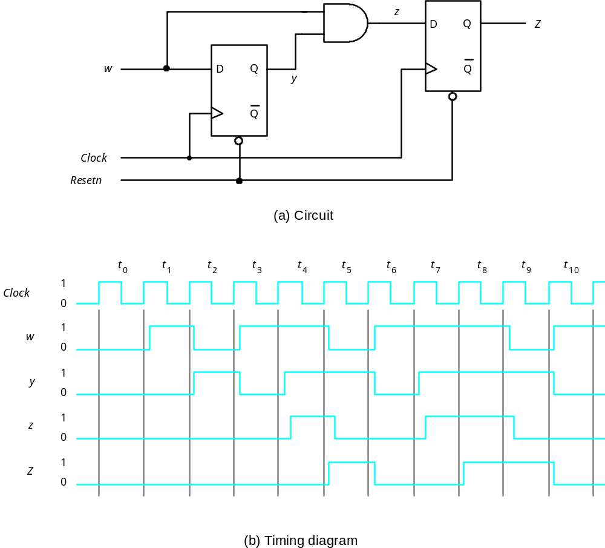
Figure 8.27. Circuit that implements the specification in Figure 8.2.

Slide 29
Mealy type Example-2: Register content swap
w
=
0
A
Reset
w
=
1
⁄
R
2
out
=
1
,
R
3
in
=
1
B
w
=
0
R
1
=
1
,
R
2
=
1
w
=
1
out
in
C
w
=
0
R
3
=
1
,
R
1
=
1
,
Done
=
1
w
=
1
out
in
Figure 8.28. State diagram for register content swap example

Slide 30
Verilog code for Moore-Type FSM
Clockcycle:
t
0
t
1
t
2
t
3
t
4
t
5
t
6
t
7
t
8
t
9
t
10
w
:
0
1
0
1
1
0
1
1
1
0
z
:
0
0
0
0
0
1
0
0
1
1
0
module simple (Clock, Resetn, w, z);
input Clock, Resetn, w;
output z;
reg [2:1] y, Y;
parameter [2:1] A=2’boo, B=2’b01, C=2’b10
//Define the next state combinational circuit
always@(w or y)
case (y)
A: if(w) Y=B;
else Y=A;
B: if(w) Y=C
else Y=A;
C: if(w) Y=C;
else Y=A;
default: Y=2’bxx;
endcase
//Define the sequential block
always@(negedge Resetn or posedge Clock)
if (Resetn==0) y<=A;
else y<=Y;
//Define output
Assign z=(y==C);
endmodule

Slide 31
Verilog code for Mealy-Type FSM
Clock cycle:
t
0
t
1
t
2
t
3
t
4
t
5
t
6
t
7
t
8
t
9
t
10
w
:
0
1
0
1
1
0
1
1
1
0
1
z
:
0
0
0
0
1
0
0
1
1
0
0
module mealy (Clock, Resetn, w, z);
input Clock, Resetn, w;
output z;
reg y, Y, z;
parameter A=0, B=1
//Define the next state combinational circuit
always@(w or y)
case (y)
A: if(w)
begin
z=0;
Y=B;
end
else
begin
z=0;
Y=A;
end
B: if(w)
begin
z=1;
Y=B;
end
else
begin
z=0;
Y=A;
end
endcase
//Define the sequential block
always@(negedge Resetn or posedge Clock)
if (Resetn==0) y<=A;
else y<=Y;
endmodule

Slide 32
A
a
Shift register
Adder
s
FSM
Shift register
Shift register
b
Sum
=
A
+
B
B
Clock
Figure 8.39. Block diagram for the serial adder.

Slide 33
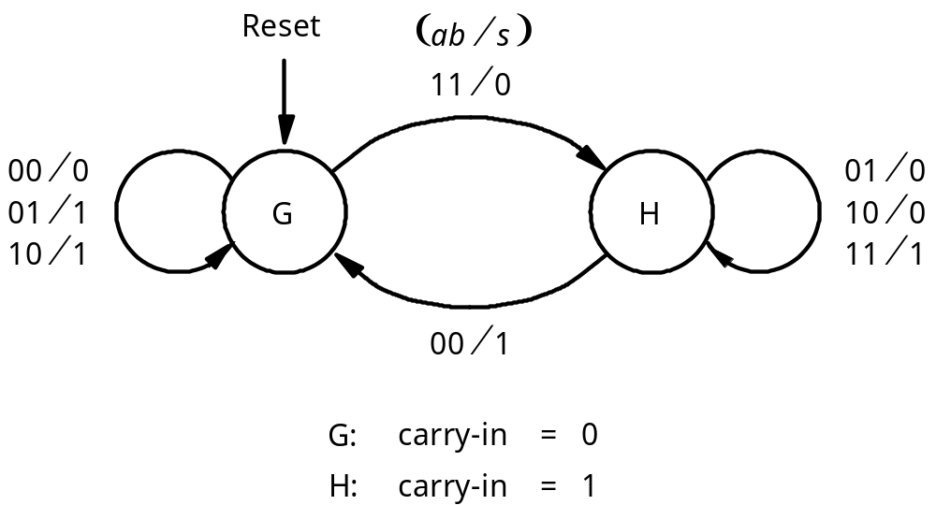
Figure 8.40. State diagram for the serial adder FSM.

Slide 34
Present
Next state
Output
s
state
ab
=00
01
10
11
00
01
10
11
G
G
G
G
H
0
1
1
0
H
G
H
H
H
1
0
0
1
Figure 8.41. State table for the serial adder FSM.
Next state
Output
Present
state
ab
=00
01
10
11
00
01
10
11
y
Y
s
0
0
0
0
1
0
1
1
0
1
0
1
1
1
1
0
0
1
Figure 8.42. State-assigned table for Figure 8.41.
Y=ab + ay + by; s=a⊕b⊕y

Slide 35
a
s
b
Full
adder
Y
y
D
Q
carry-out
Clock
Q
Reset
Y=ab + ay + by; s=a⊕b⊕y
Figure 8.43. Circuit for the adder FSM in Figure 8.39.

Slide 36
Reset
⁄
11
⁄
01
00
G
0
s
=
0
H
0
s
=
0
10
00
01
00
11
01
10
11
10
01
G
⁄
s
=
1
H
⁄
s
=
1
11
10
1
00
1
Figure 8.44. State diagram for the Moore-type serial adder FSM.

Slide 37
Present
Nextstate
Output
state
ab
=00
01
10
11
s
G
0
G
0
G
1
G
1
H
0
0
G
1
G
0
G
1
G
1
H
0
1
H
0
G
1
H
0
H
0
H
1
0
H
1
G
1
H
0
H
0
H
1
1
Figure 8.45. State table for the Moore-type serial adder FSM.

Slide 38
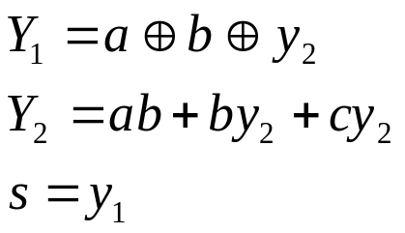
Nextstate
Present
state
ab
=00
01
10
11
Output
y
2
y
1
s
Y
2
Y
1
00
0
0
01
0
1
10
0
01
0
0
01
0
1
10
1
10
0
1
10
1
0
11
0
11
0
1
10
1
0
11
1
Figure 8.46. State-assigned table for Figure 8.45.

Slide 39
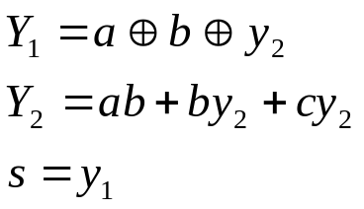
Sum bit
Y
1
y
1
a
D
Q
s
b
Full
adder
Carry-out
Q
Y
2
y
2
D
Q
Clock
Q
Reset
Figure 8.47. Circuit for the Moore-type serial adder FSM.

Slide 40
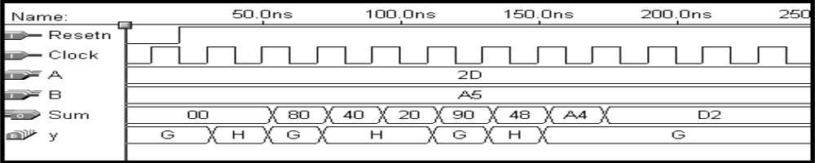
1
0
0
0
a
a
D
D
D
D
7
0
3
2
1
0
L
E
Counter
L
0
w
Q
Q
Q
Q
1
E
3
2
1
0
b
b
Adder
7
0
FSM
Run
L
0
0
0
w
1
E
L
w
E
Clock
Reset
Sum
Sum
7
0
Figure 850 Synthesized circuit and simulation result

Slide 41
Clock
sense
N
sense
D
N
D
(a) Timing diagram
N
sense
D
Q
D
Q
N
Clock
Q
Q
(b) Circuit that generates
N
Figure 8.53. Signals for the vending machine Example 8.7

Slide 42
DN
Reset
DN
DN
S1
⁄
0
DN
DN
DN
D
N
S4
⁄
1
S2
⁄
0
S3
⁄
0
D
S7
⁄
1
N
D
N
DN
S5
⁄
1
S6
⁄
0
DN
DN
N
D
S8
⁄
1
S9
⁄
1
Figure 8.54. State diagram for Example 8.7

Slide 43
Present
Next state
Output
state
DN
=00
01
10
11
z
S1
S1
S3
S2
–
0
S2
S2
S4
S5
–
0
S3
S3
S6
S7
–
0
S4
S1
–
–
–
1
S5
S3
–
–
–
1
S6
S6
S8
S9
–
0
S7
S1
–
–
–
1
S8
S1
–
–
–
1
S9
S3
–
–
–
1
Figure 8.55. State table for Example 8.7

Slide 44
Present
Next state
Output
state
DN
=00
01
10
11
z
S1
S1
S3
S2
–
0
S2
S2
S4
S5
–
0
S3
S3
S2
S4
–
0
S4
S1
–
–
–
1
S5
S3
–
–
–
1
Figure 8.56. Minimized state table for Example 8.7

Slide 45
DN
S1
⁄
0
N
DN
S3
⁄
0
D
DN
N
DN
DN
S2
⁄
0
D
S5
⁄
1
N
D
S4
⁄
1
Figure 8.57. Minimized state diagram for Example 8.7

Slide 46
DN
⁄
0
S1
N
⁄
0
D
⁄
1
DN
⁄
0
N
⁄
1
S3
D
⁄
0
N
⁄
0
D
⁄
1
S2
DN
⁄
0
Figure 8.58. Mealy-type FSM for Example 8.7

Slide 47
Present
Next state
Output
z
state
w
=
0
w
=
1
w
=
0
w
=
1
A
B
C
0
0
B
D
–
0
–
C
F
E
0
1
D
B
G
0
0
E
F
C
0
1
F
E
D
0
1
G
F
–
0
–
Figure 8.59. Incompletely specified state table for Example 8.7.

Slide 48
Design of Counter using Sequential Circuit Approach with D Flip-flop
w
=
0
w
=
0
w
=
0
w
=
0
w
=
1
w
=
1
w
=
1
A/0
B/1
C/2
D/3
w
=
1
w
=
1
H/7
G/6
F/5
E/4
w
=
1
w
=
1
w
=
1
w
=
0
w
=
0
w
=
0
w
=
0
Figure 8.60. State diagram for the counter.

Slide 49
Present
Next state
Output
state
w
=
0
w
=
1
A
A
B
0
B
B
C
1
C
C
D
2
D
D
E
3
E
E
F
4
F
F
G
5
G
G
H
6
H
H
A
7
Figure 8.61. State table for the counter.

Slide 50
Next state
Present
Count
state
w
=
0
w
=
1
y
2
y
1
y
0
z
2
z
1
z
0
Y
2
Y
1
Y
0
Y
2
Y
1
Y
0
A
000
000
001
000
B
001
001
010
001
C
010
010
011
010
D
011
011
100
011
E
100
100
101
100
F
101
101
110
101
G
110
110
111
110
H
111
111
000
111
Figure 8.62. State-assigned table for the counter.

Slide 51
y
1
y
0
y
1
y
0
wy
2
wy
2
00
01
11
10
00
01
11
10
00
0
1
1
0
00
0
0
1
1
01
0
1
1
0
01
0
0
1
1
11
1
0
0
1
11
0
1
0
1
10
1
0
0
1
10
0
1
0
1
Y
0
=
wy
0
+
wy
0
Y
1
=
wy
1
+
y
1
y
0
+
wy
0
y
1
y
1
y
0
wy
2
00
01
11
10
00
0
0
0
0
01
1
1
1
1
11
1
1
0
1
10
0
0
1
0
Y
2
=
wy
2
+
y
0
y
2
+
y
1
y
2
+
w
y
0
y
1
y
2
Figure 8.63. Karnaugh maps for D flip-flops for the counter.

Slide 52
w
Y
0
y
D
Q
0
Q
Y
1
D
Q
y
1
Q
Y
2
D
Q
y
2
Q
Clock
Resetn
Modulo 8 counter with D- FF

Slide 53
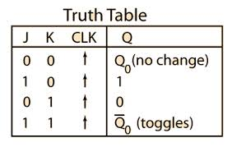
Modulo 8 counter with J-K Flip-Flop
If a flip-flop in state 0 is to remain in state 0, then J=0 and K=d
If a flip-flop in sate 0 is to change to state 1, then J=1 and K=d
If a flip-flop in state 1 is to remain in state 1, then J=d and K=0
If a flip-flop in state 1 is to change to state 0, then J=d and K=1

Slide 54
Present
Flip-flop inputs
state
w
=
0
w
=
1
Count
y
2
y
1
y
0
z
2
z
1
z
0
Y
2
Y
1
Y
0
J
2
K
2
J
1
K
1
J
0
K
0
Y
2
Y
1
Y
0
J
2
K
2
J
1
K
1
J
0
K
0
A
000
000
0d
0d
0d
001
0d
0d
1d
000
B
001
001
0d
0d
d0
010
0d
1d
d1
001
C
010
010
0d
d0
0d
011
0d
d0
1d
010
D
011
011
0d
d0
d0
100
1d
d1
d1
011
E
100
100
d0
0d
0d
101
d0
0d
1d
100
F
101
101
d0
0d
d0
110
d0
1d
d1
101
G
110
110
d0
d0
0d
111
d0
d0
1d
110
H
111
111
d0
d0
d0
000
d1
d1
d1
111
Figure 8.65. Excitation table for the counter with JK flip-flops.

Slide 55
y
1
y
0
y
1
y
0
wy
2
00
01
11
10
wy
2
00
01
10
00
0
d
d
0
00
d
0
0
d
01
0
d
d
0
01
d
0
0
d
11
1
d
d
1
11
d
1
1
d
10
1
d
d
1
10
d
1
1
d
J
0
=
w
K
0
=
w
y
1
y
0
y
1
y
0
wy
2
00
01
11
10
wy
2
00
01
10
00
0
0
d
d
00
d
d
0
0
01
0
0
d
d
01
d
d
0
0
11
0
1
d
d
11
d
d
1
0
10
0
1
d
d
10
d
d
1
0
J
1
=
wy
0
K
1
=
wy
0

Slide 56
y
1
y
0
y
1
y
0
wy
2
00
01
11
10
wy
2
00
01
10
00
0
0
0
0
00
d
d
d
d
01
d
d
d
d
01
0
0
0
0
11
d
d
d
d
11
0
0
1
0
10
0
0
1
0
10
d
d
d
d
J
2
=
wy
0
y
1
K
2
=
wy
0
y
1

Slide 57
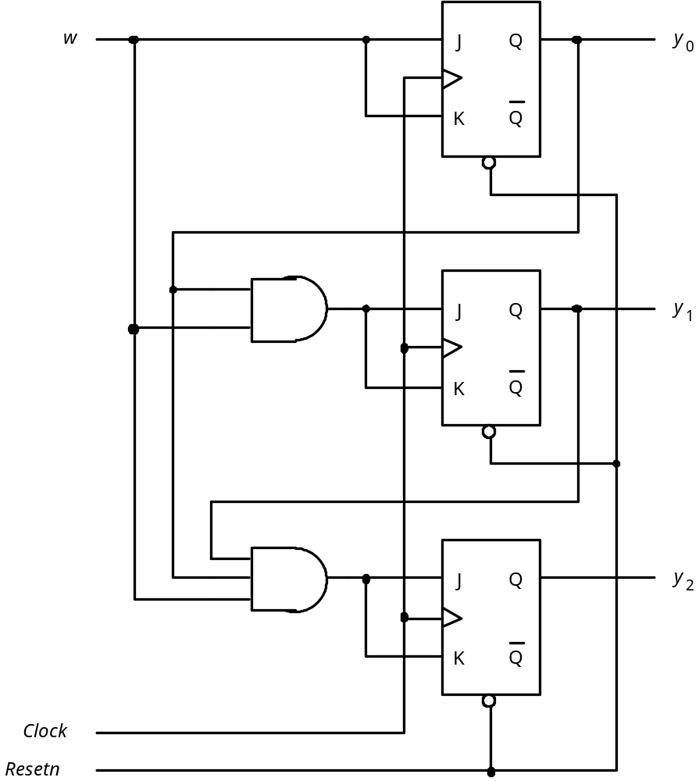
J₀=K₀=w
J₁=K₁=wy₀
J₂=K₂=wy₀y₁
Figure 8.67. Circuit diagram using JK flip-flops.

Slide 58
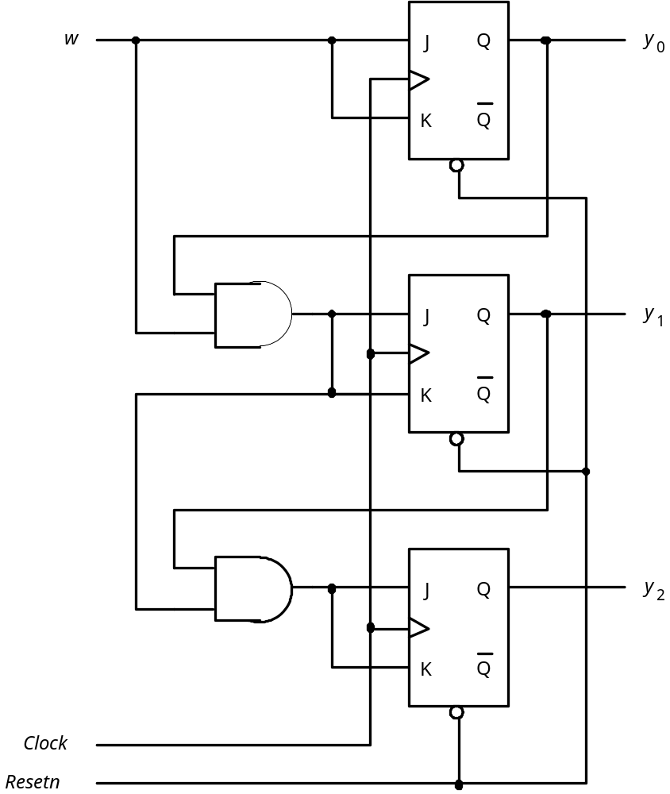
Figure 8.68. Factored-form implementation of the counter.

Slide 59
A different Counter that counts 0,4,2,6,1,5,3,7,0,1
Present
Next
Output
state
state
z
2
z
1
z
0
A
B
000
B
C
100
C
D
010
D
E
110
E
F
001
F
G
101
G
H
011
H
A
111
Figure 8.69. State table for the counterlike example.

Slide 60
A different Counter that counts 0,4,2,6,1,5,3,7,0,1
Present
Next
Output
state
state
y
2
y
1
y
0
Y
2
Y
1
Y
0
z
2
z
1
z
0
000
1
00
0
00
100
0
10
1
00
010
1
10
0
10
110
0
01
1
10
001
1
01
0
01
101
0
11
1
01
011
1
11
0
11
111
0
00
1
11
Figure 8.70. State-assigned table for Figure 8.69.

Slide 61
A different Counter that counts 0,4,2,6,1,5,3,7,0,1
D
Q
z
2
Q
D
Q
z
1
Q
D
Q
z
0
w
Q
Figure 8.71. Circuit for Figure 8.70.

Slide 62
State name
Output signals
0 (False)
Condition
1 (True)
or actions
expression
(Moore type)
(a) State box
(b) Decision box
Conditional outputs
or actions (Mealy type)
(c) Conditional output box
Figure 8.86. Elements used in ASM charts.

Slide 63
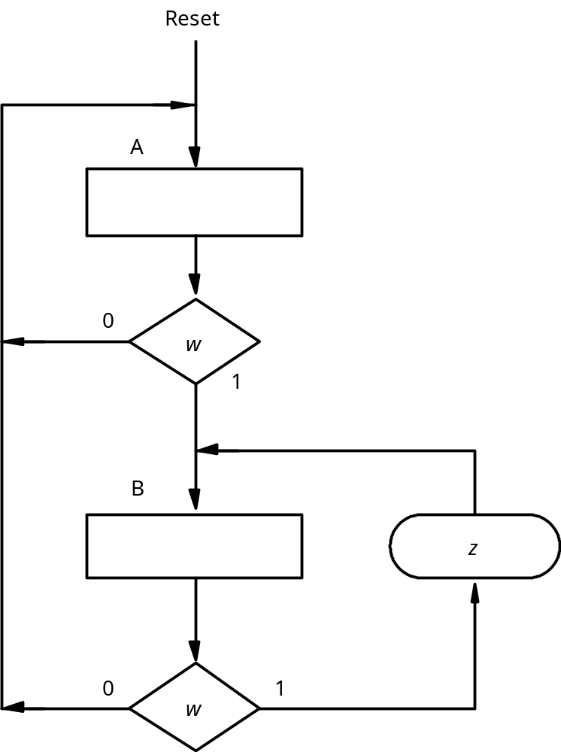
1
=
z
⁄
1
=
w
B
0
0
=
=
z
z
⁄
⁄
1
0
=
=
w
w
Reset
A
0
=
z
⁄
0
=
w
Figure 8.88. ASM chart for the FSM in Figure 8.23.

Slide 64
Reset
000
Idle
0xx
1xx
gnt1
⁄
g
=
1
1
x0x
1xx
01x
gnt2
⁄
g
=
1
2
xx0
x1x
001
gnt3
⁄
g
=
1
3
xx1
Figure 8.72. State diagram for the arbiter.

Slide 65
Reset
r
1
r
2
r
3
Idle
r
1
r
1
gnt1
⁄
g
=
1
1
r
r
1
r
r
2
1
2
gnt2
⁄
g
=
1
2
r
3
r
2
r
r
r
1
2
3
gnt3
⁄
g
=
1
3
r
3
Figure 8.73. Alternative style of state diagram for the arbiter.

Slide 66
Please see “portrait orientation” PowerPoint file for Chapter 8
Figure 8.74. VHDL code for the arbiter.

Slide 67
.
.
.
PROCESS( y )
BEGIN
IF y = gnt1 THEN g(1) <= '1' ;
ELSIF y = gnt2 THEN g(2) <= '1' ;
ELSIF y = gnt3 THEN g(3) <= '1' ;
END IF ;
END PROCESS ;
END Behavior ;
Figure 8.75. Incorrect VHDL code for the grant signals.

Slide 68
.
.
.
PROCESS( y )
BEGIN
g(1) <= '0' ;
g(2) <= '0' ;
g(3) <= '0' ;
IF y = gnt1 THEN g(1) <= '1' ;
ELSIF y = gnt2 THEN g(2) <= '1' ;
ELSIF y = gnt3 THEN g(3) <= '1' ;
END IF ;
END PROCESS ;
END Behavior ;
Figure 8.76. Correct VHDL code for the grant signals.

Slide 69
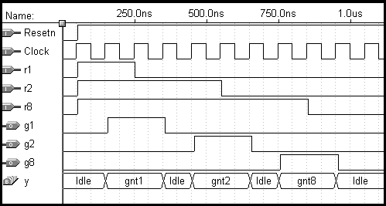
Figure 8.77. Simulation results for the arbiter circuit.

Slide 70
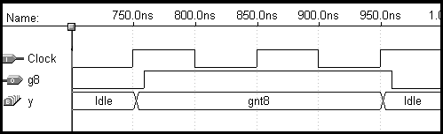
Figure 8.78. Output delays in the arbiter circuit.

Slide 71
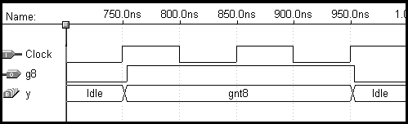
Figure 8.79. Output delay when using one-hot encoding.

Slide 72
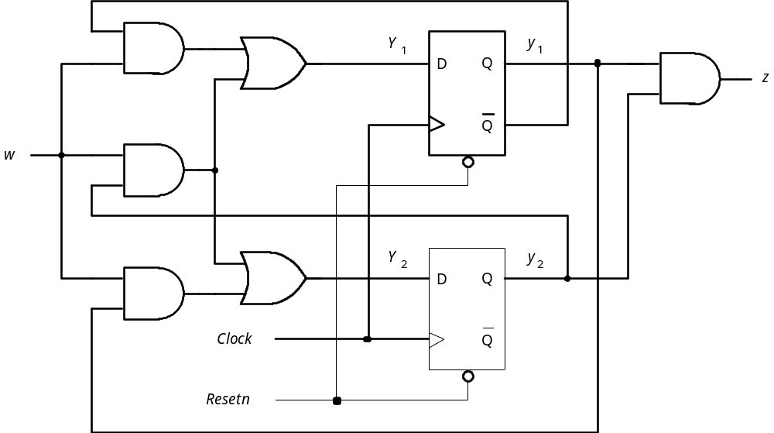
Figure 8.80. Circuit for Example 8.8.

Slide 73
Present
Next State
state
w
=
0
w
=
1
Output
Next state
Present
Output
y
2
y
1
z
state
z
Y
Y
Y
Y
w
=
0
w
=
1
2
1
2
1
0
0
0
0
01
0
A
A
B
0
0
1
0
0
10
0
B
A
C
0
1
0
0
0
11
0
C
A
D
0
1
1
0
0
11
1
D
A
D
1
(a) State-assigned table
(b) State table
Figure 8.81. Tables for the circuit in Example 8.80.

Slide 74
J
y
1
w
1
J
Q
z
K
Q
K
1
J
2
y
2
J
Q
Clock
K
Q
K
2
Resetn
Figure 8.82. Circuit for Example 8.9.

Slide 75
Present
Flip-flop inputs
state
w
=
0
w
=
1
Output
y
2
y
1
z
J
2
K
2
J
1
K
1
J
2
K
2
J
1
K
1
00
01
0
1
0
0
1
1
0
01
01
0
1
1
0
1
1
0
10
01
0
1
0
0
1
0
0
11
01
0
1
1
0
1
0
1
Figure 8.83. The excitation table for the circuit in Figure 8.82.

Slide 76
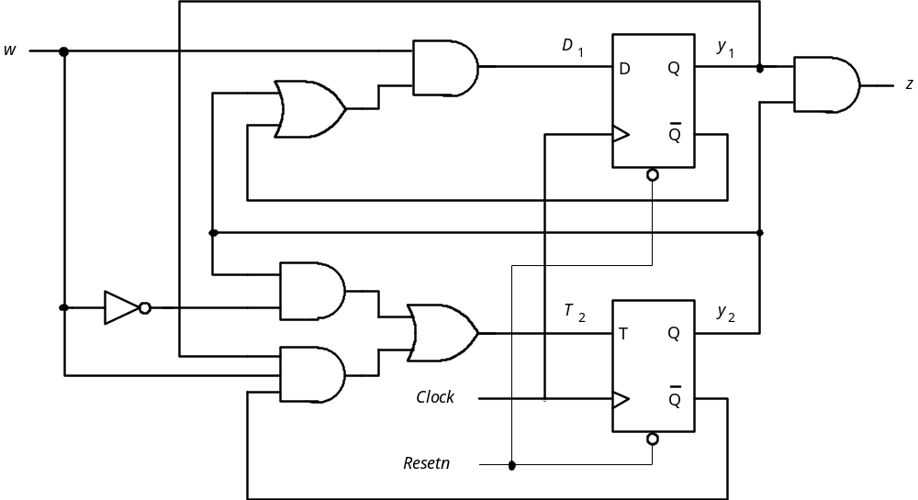
Figure 8.84. Circuit for Example 8.10.

Slide 77
Present
Flip-flop inputs
Output
state
w
=
0
w
=
1
y
y
z
2
1
T
D
T
D
2
1
2
1
0
0
0
0
01
0
0
1
0
0
10
0
1
0
1
0
01
0
1
1
1
0
01
1
Figure 8.85. Excitation table for the circuit in Figure 8.84.

Slide 78
State name
Output signals
0 (False)
Condition
1 (True)
or actions
expression
(Moore type)
(a) State box
(b) Decision box
Conditional outputs
or actions (Mealy type)
(c) Conditional output box
Figure 8.86. Elements used in ASM charts.

Slide 79
Please see “portrait orientation” PowerPoint file for Chapter 8
Figure 8.87. ASM chart for the FSM in Figure 8.3.

Slide 80
Figure 8.88. ASM chart for the FSM in Figure 8.23.

Slide 81
Reset
Idle
1
r
1
0
gnt1
1
0
g
1
r
1
1
r
2
0
gnt2
1
0
g
2
r
2
0
1
r
3
gnt3
1
0
g
3
r
3
Figure 8.89. ASM chart for the arbiter FSM in Figure 8.73.

Slide 82
w
z
1
1
Inputs
Outputs
w
Combinational
z
n
m
circuit
y
Y
k
k
Present-state
Next-state
variables
variables
y
1
Y
1
Figure 8.90. The general model for a sequential circuit.

Slide 83
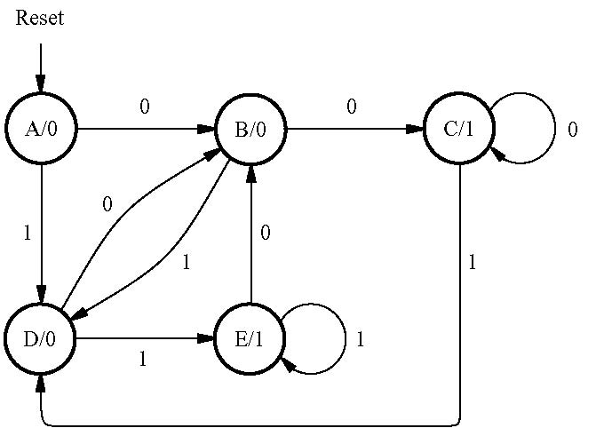
Figure 8.91. State diagram for Example 8.11.

Slide 84
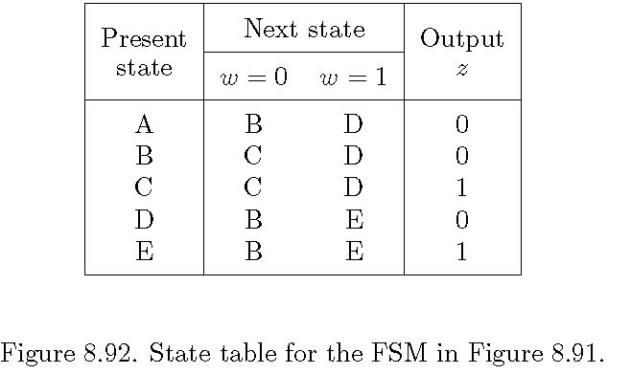

Slide 85
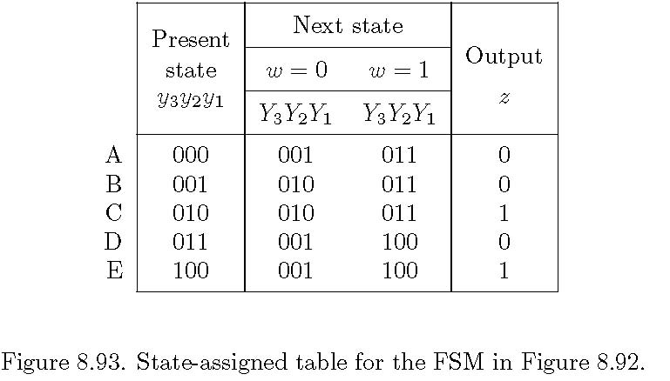

Slide 86
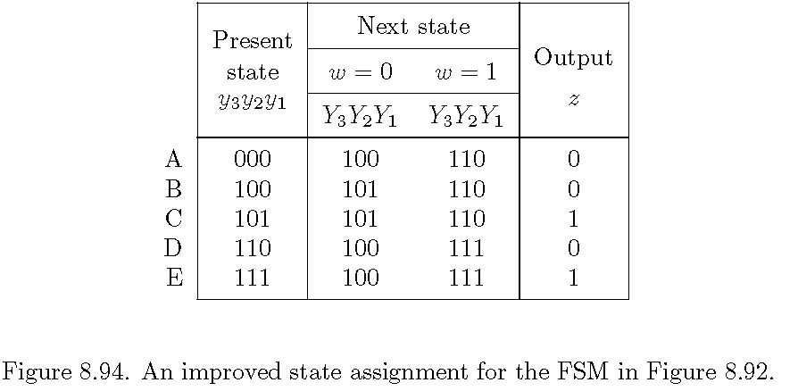

Slide 87
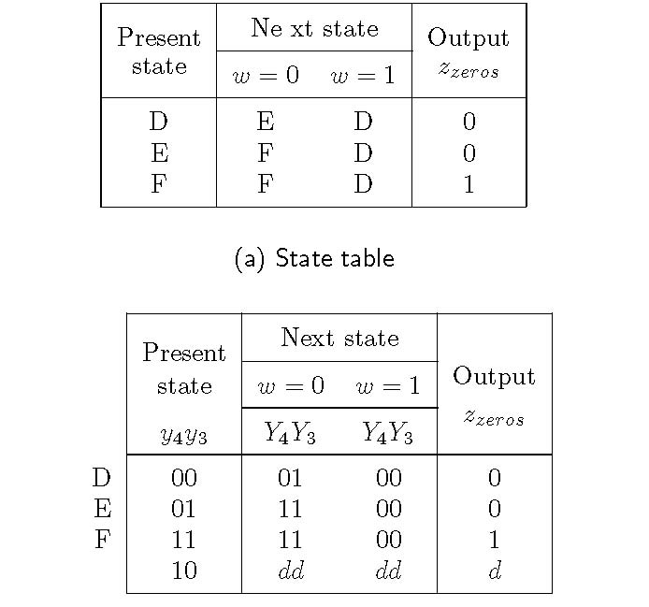
Figure 8.95. FSM that detects a sequence of two zeros.

Slide 88
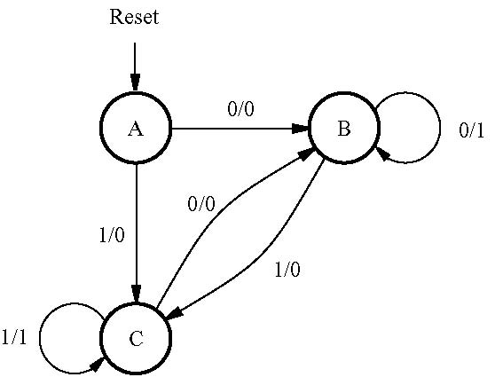
Figure 8.96. State diagram for Example 8.13.

Slide 89
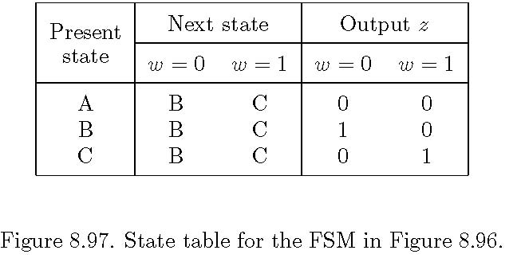

Slide 90
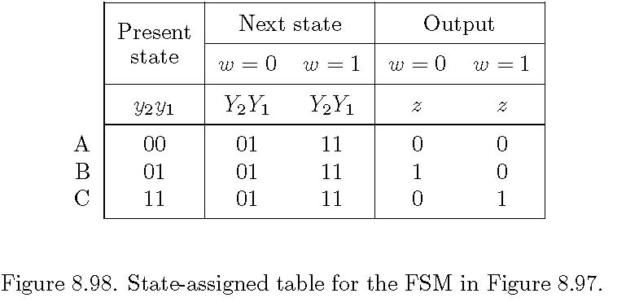

Slide 91
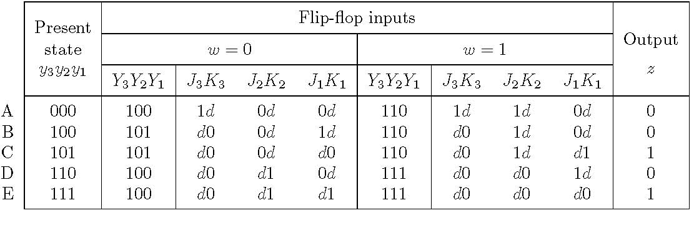
Figure 8.99. Excitation table for the FSM in Figure 8.94
with JK flip-flops.

Slide 92
Please see “portrait orientation” PowerPoint file for Chapter 8
Figure 8.100. VHDL code for the FSM in Figure 8.91.

Slide 93
Please see “portrait orientation” PowerPoint file for Chapter 8
Figure 8.101. VHDL code for the FSM in Figure 8.96.

Slide 94
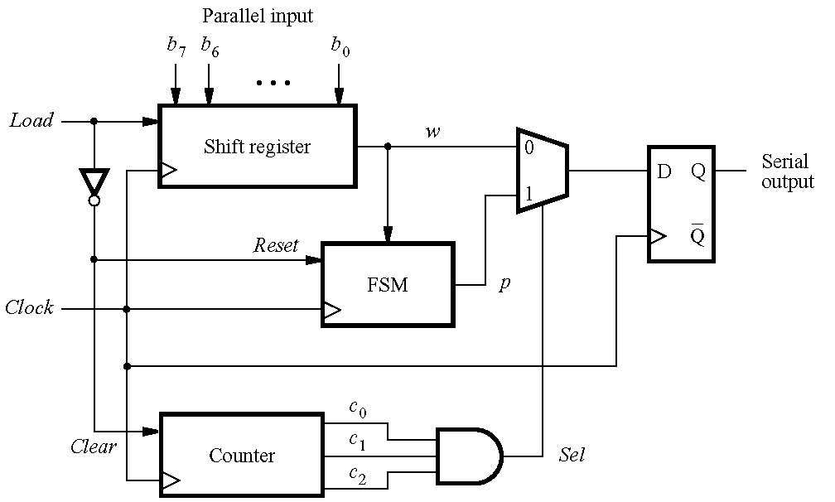
Figure 8. 102. Parallel-to-serial converter.

Slide 95
Please see “portrait orientation” PowerPoint file for Chapter 8
Figure 8.103. FSM for parity generation.

Slide 96
Present
Next
state
state
w
=
0
w
=
1
Output
y
2
y
1
Y
Y
Y
Y
z
2
1
2
1
0
0
1
0
1
1
0
0
1
0
1
0
0
0
1
0
1
1
0
0
0
1
1
1
0
0
1
1
Figure P8.1. State-assigned table for problems 8.1 and 8.2.

Slide 97
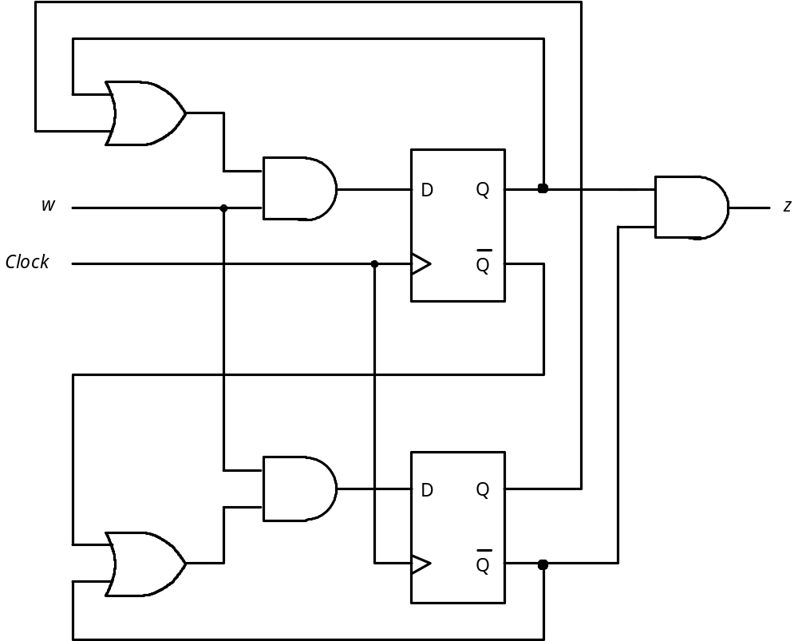
Figure P8.2. Circuit for problem 8.29.

